Slide 1



Seminar 4
Incorporating Missing Information from Vision in Multimodal Dialogue System
Cao Qian
Jin Chuhao
2021.06.08

Slide 2

Contents
Motivation
Proposed Methods
Experiments Plan
Future Work

Slide 3

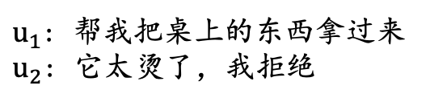
1. Motivation
Missing information in dialogue systems
Only text information: missing visual expression
Limitation of multi-modal dialogue systems: dependence
Dataset
Expensive, Dirty
Not targeted
Embedding space of different modality
$u_{1}$: 帮我把桌上的东西拿过来
$u_{2}$: 它太烫了，我拒绝

Slide 4
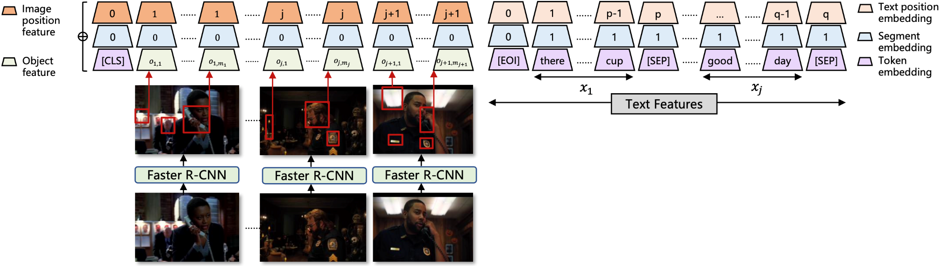



2. Proposed Methods
Project texts and images into the same semantic feature space
Text
Transformer Decoder
4
Transformer Encoder
Wenlan
Text

Slide 5
2. Proposed Methods
Project texts and images into the same semantic feature space
Segment/modal embedding only marks different modalities, processing different level features from different spaces will increase the burden of the model;
Multimodal Dialogue model should focus on extracting missing information from vision, and separated the semantic level image understanding task from the generation model.
Text
Transformer Decoder
Transformer Encoder
Wenlan
Text

Slide 6
2. Proposed Methods
(2) Constructing multimodal dataset
Based on the single-modal dataset, mask the content words (Nouns, verbs, etc);
Using the masked content words to retrieve related sentences, then use these sentences to retrieve the relevant images by multimodal model;
Adding these retrieved images as supplementary information.
Based on above methods, we can build a larger multi-modal dataset by a clean single-modal dataset.

Slide 7
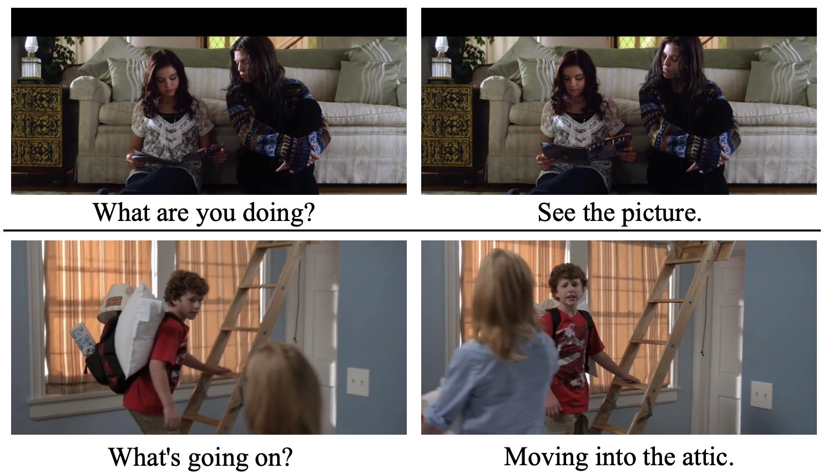
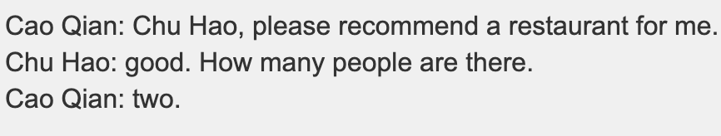
2. Proposed Methods
(3) Joint training：Mix multi-modal dataset and single-modal dataset
Train the dialogue generation model on multi-modal data and single-modal data simultaneously;
Maintain the performance of the model in the dialogue task, and make it learn to find the missing information from the visual information;

Slide 8
Experiments Plan
使用文澜模型把文本和语义映射到同一空间
GPT-2/T5
Unsplash：一个大型图像库
多模态数据集：Openvidial
高质量的对话数据集

Slide 9
Future Work
现实世界中，文本缺失模态信息的方式多为隐式缺失，以单模态数据集为基础构建的多模态数据集为显式缺失；
探究多模态的预训练文本生成模型，以其他模态作为辅助，侧重于如何从其他模态中获取文本模态中缺失的信息；

Slide 10
Thanks!

